Slide 1
Dairy Business in Pakistan
Guest Speaker
Mr. Ajaz Rahim
Executive Director at B.T. Farms & Organique Whole Foods

Slide 2
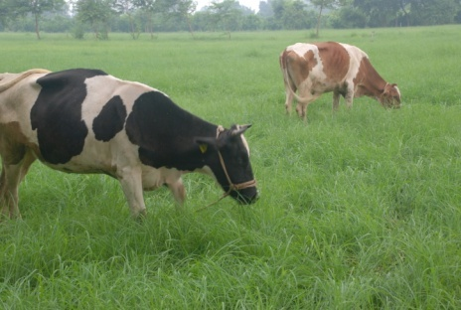
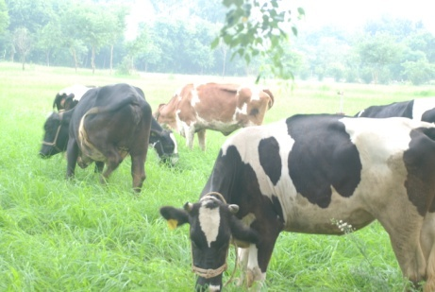
Chart of Accounts
Daily Milk Yield 20 Liters
Price of Milk Rs. 45/-
Total Milk Sale Rs. 900/-
Feed Cost Rs. 450/-
Management
Medical
Insemination Rs. 115/-
Insurance Rs. 35/-
Remaining Profit per day Rs. 300/

Slide 3
Cost of Management
Electricity Rs. 70,000/-
Medicine Rs. 30,000/-
Insemination Rs. 60,000/-
Repair & Maintenance Rs. 20,000/-
Salary structure:
8 workers Rs. 80,000/-
2 Security Guards Rs. 20,000/-
1 DVM Rs. 30,000/-
Accountant Rs. 25,000/-
Total Salaries Rs. 155,000/-
Total Expenses Rs. 335,000/-

Slide 4
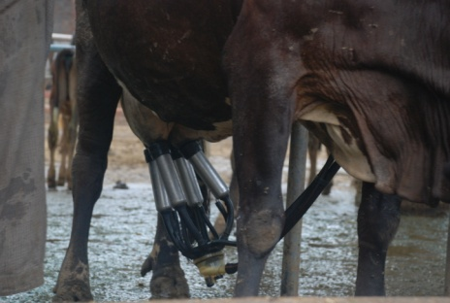
Milk Cycle Graph
300 days cycle

Slide 5
P&L
300 days x Rs. 300 Rs.90,000/-
60 days x Rs. 600 Rs.36,000/-
Profit Rs. 54,000/-
Calf Feed 60 x Rs. 130 Rs. 7,800/-
Profit Rs. 46,200/-
First Insemination 30 x 600 Rs. 18,000/-
Profit Rs. 28,200/-
Second Insemination30x600 Rs. 18,000/-
Remaining Profit Rs. 10,200/-
Depreciation Rs.300,000 / 5 Rs. 60,000/-

Slide 6
Key Points
Biggest business risk is REPRODUCTION
Don’t rely on AI, it should be a bonus
Priority in feed & management should be to aid effective reproduction
No amount of incremental milk yield is worth compromising on reproduction cycle
Don’t fall in love with your cows, cull them efficiently
Fix your farm size and sell animals consistently to be known as a breeding farm

Slide 7
So Far So Good

Slide 8
Thank you

